Slide 2
Deadlock Prevention
Pranish Maharjan

Slide 3
Deadlock
Situation where processes are waiting for the resources, held by another process, for an infinite time
No processes are executed
A long-term starvation
Infinite waiting for recourses
Notes:
Before getting started lets start with what a deadlock is

Slide 4
Condition for Deadlock
Hold and Wait
No Preemption
Mutual Exclusion
Circular Wait

Slide 5
Deadlock Prevention
Frequent deadlocks cause an issue.
So it is important to prevent a system from deadlock, hence deadlock prevention.
All the four conditions mentioned before are the criteria for a deadlock to occur.
If and only if we violate one of the criteria then deadlock can never occur.

Slide 6
Eliminate Mutual Exclusion
If a resource can simultaneously be used by multiple process then mutual exclusion can be avoided and so can be deadlock.
Regardless of this cool idea, it is not practically possible.
Some resources cannot be forced to be used by more than one process simultaneously.
Namely printer, tape drive, keyboard input and many more.

Slide 7
Eliminate Hold and Wait
Hold and Wait can be eliminated if all the resource required by a process is assigned to it before its execution.
This is practically possible but may lead to:
Low system utilization
Starvation

Slide 8
Eliminate No Preemption
In no preemption, no process can kill other low priority process to gain the required resources.
This is practically possible but is not desired.
If no preemption is avoided, then deadlock cannot occur but when a higher priority process kills a lower priority process, then it will have to start all the execution from the beginning, this is not desired.

Slide 9
Eliminate Circular Wait
For a deadlock to occur, it must create a loop of processes and resources.
Breaking the loop can make a system deadlock free.
This is an practical idea.
This can be achieved by:
Assigning a numerical number to every resource
A process can only request resource in increasing/decreasing order.
If a process is using R3 and requests for R4 (in increasing order) then it cannot request R2, this will avoid the deadlock.

Slide 10
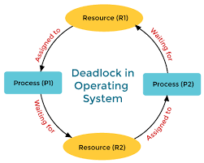
Deadlock between Few Processes

Slide 11
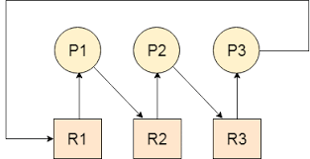
Example
Another

Slide 12
Any Queries?
Questioning Area

Slide 13
धन्यवाद
☺
May you have a great day
☺
☺

